Slide 1
Cmpe 493 Information retrieval Fall’21 Term Project
Meltem Arslan - 2016400117,
Gülsüm Tuba Çibuk Girgin - 2021700036

Slide 2


PreprocessIng
Pandas and nltk libraries are used.
In order to operate easily on the dataset, we chose to use dataframes of the Pandas library. We also used the natural language toolkit for preprocessing steps.
Title, abstract, and keywords columns are chosen.
After examining the features of the dataset, we decided to include only three features. These features are title, abstract, and keywords.

Slide 3
PreprocessIng
Applied preprocessing steps are shown in the table here.
Procedure | Library
Case folding | python standard library
Punctuation Removal | string library
Tokenization | nltk library
Stopword Removal | nltk library
Lemmatization | nltk library
Stemming | nltk library

Slide 4
STATISTICS
If we look at the number of documents in each class, we clearly see that the number of the documents in the prevention class is higher than others. Transmission and Epidemic Forecasting classes have less documents. In each document, token numbers are close to each other.
Classes | # Documents | Mean # Tokens
Treatment | 8717 | 153
Diagnosis | 6193 | 163
Prevention | 11102 | 141
Mechanism | 4438 | 139
Transmission | 1088 | 145
Epidemic Forecasting | 645 | 145
Case Report | 2063 | 106

Slide 5
General approach
After preprocessing, the data needed be converted into required format. Since the problem is multiclass and multilabel problem. The data could not directly be given to the classifiers. So, we have followed a binary approach for each class and looked out their existences in each sample. Then, the results were combined in a csv file as requested for evaluation.
Classes | Sample x
Treatment | 1
Diagnosis | 1
Prevention | 0
Mechanism | 0
Transmission | 0
Epidemic Forecasting | 1
Case Report | 0

Slide 6
APPLIED METHODS
Naive Bayes
KNN

Slide 7
K-NEAREST NEIGHBORS
Pipeline
Count Vectorizer
Tf-Idf
KNN

Slide 8
K-NEAREST NEIGHBORS
Evaluation Results
Tested with provided evaluation script.
 | Precision | Recall | F1-score | Support
Treatment | 0.8043 | 0.8174 | 0.8108 | 2207
Diagnosis | 0.7565 | 0.7477 | 0.7521 | 1546
Prevention | 0.8934 | 0.8687 | 0.8809 | 2750
Mechanism | 0.8262 | 0.7176 | 0.7681 | 1073
Transmission | 0.5549 | 0.3555 | 0.4333 | 256
Epidemic Forecasting | 0.7284 | 0.6146 | 0.6667 | 192
Case Report | 0.7467 | 0.3548 | 0.4810 | 482

Slide 9
K-NEAREST NEIGHBORS
 | Precision | Recall | F1-score | Support
micro avg | 0.8193 | 0.7640 | 0.7907 | 8506
macro avg | 0.7586 | 0.6395 | 0.6847 | 8506
weighted avg | 0.8147 | 0.7640 | 0.7841 | 8506
samples avg | 0.8126 | 0.7922 | 0.7857 | 8506
 | mean precision | mean recall | F1
Instance-based measures | 0.8126 | 0.7922 | 0.8023

Slide 10
NAIVE BAYES
Bernoulli Naive Bayes from scikit-learn library.
We applied Bernoulli Naive Bayes classification method from scikit-learn library to our preprocessed and vectorized dataset. The reason for choosing Bernoulli Naive Bayes instead of other types of naive bayes is that its classification accuracy was higher.

Slide 11
NAIVE BAYES
Evaluation Results
Tested with provided evaluation script.
 | Precision | Recall | F1-score | Support
Treatment | 0.8261 | 0.8115 | 0.8187 | 2207
Diagnosis | 0.7257 | 0.6947 | 0.7098 | 1546
Prevention | 0.8897 | 0.9298 | 0.9093 | 2750
Mechanism | 0.7921 | 0.8416 | 0.8161 | 1073
Transmission | 0.7500 | 0.0352 | 0.0672 | 256
Epidemic Forecasting | 1.0000 | 0.0052 | 0.0104 | 192
Case Report | 0.8733 | 0.5290 | 0.6589 | 482

Slide 12
NAIVE BAYES
 | Precision | Recall | F1-score | Support
micro avg | 0.8272 | 0.7747 | 0.8001 | 8506
macro avg | 0.8367 | 0.5496 | 0.5701 | 8506
weighted avg | 0.8284 | 0.7747 | 0.7780 | 8506
samples avg | 0.7979 | 0.8008 | 0.7807 | 8506
 | mean precision | mean recall | F1
Instance-based measures | 0.7979 | 0.8008 | 0.7993

Slide 13
NAIVE BAYES
Tested with provided evaluation script.
Looking at the results, we can say that the classification method could not correctly classify the samples whose categories are transmission and epidemic forecasting. Furthermore, it was able to classify the samples of the prevention category most. The reason for that may be the difference between the numbers of documents in these categories.

Slide 14
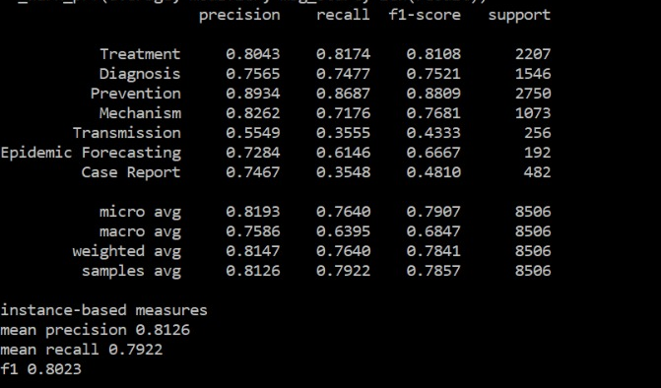
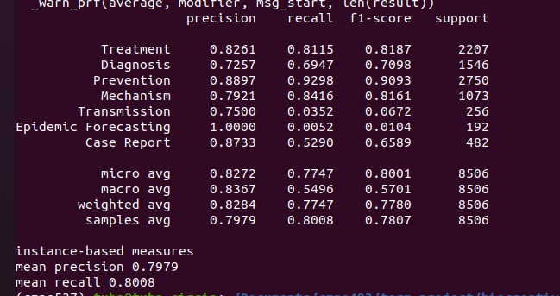
KNN vs Naive bayes

Slide 15
FUTURE PLAN
Oversampling and undersampling methods will be applied.
As mentioned in the statistics part, the dataset is unevenly distributed. Prevention category has more documents than other classes. Furthermore, transmission and epidemic forecasting categories have fewer documents. Therefore, the trained model tends to predict the category that has more data. Eventually the model becomes under fitted.
In order to solve this problem, oversampling and undersampling methods will be tested. The results of the classification with the new dataset will be compared with the results of current pipelines which consist of preprocessing, vectorizing, knn and naive bayes.

Slide 16
FUTURE PLAN
Pretrained deep models will be used and compared. (like HuggingFace models)
There are various pretrained deep models for text classification. Huggingface is a popular platform for nlp tasks and also text classification. An appropriate model will be selected and tested.

Slide 17
REFERENCES
pandas https://pandas.pydata.org/
nltk https://www.nltk.org/
scikit-learn https://scikit-learn.org/stable/
HuggingFace https://huggingface.co/

